Slide 1

Staying Healthy at

Slide 2
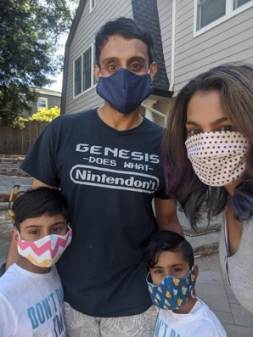
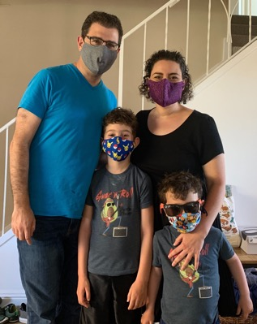
We are going back to school! I’m excited to see my teachers, classroom, and friends. At school, there are some things that will be new and different.
My family will wear masks when they drop me off. The masks cover their mouths and noses, but we can still see their eyes! They wear the masks to keep everyone at school healthy and safe.

Slide 3
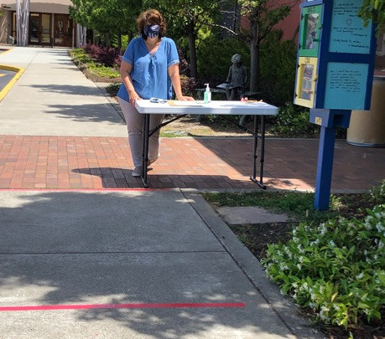
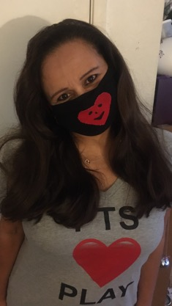
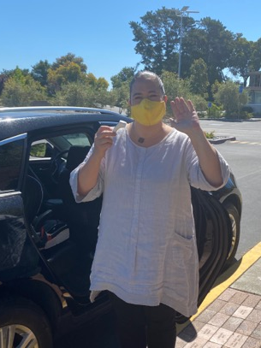
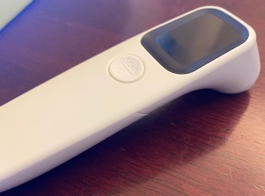
When we arrive at school, we will park and put on our masks. Will will then line up on the red lines on the front walk and stay close to our families. It’s important to stay on the lines and give other people plenty of space.
When it is our turn at the front of the line, a teacher will say hello to me. The teacher will be wearing a mask and will take my temperature.

Slide 4
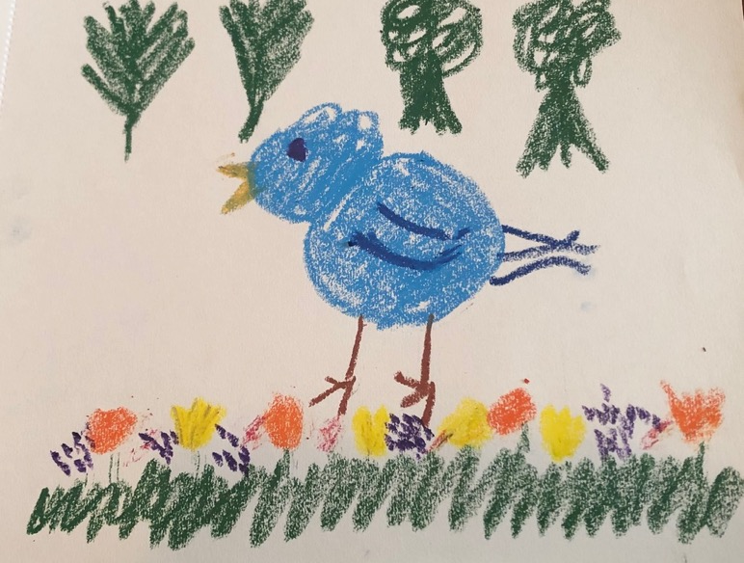
I might have to wait a little bit with my family to get to the front of the line. That’s okay. I can look for birds or sing songs while I wait.

Slide 5
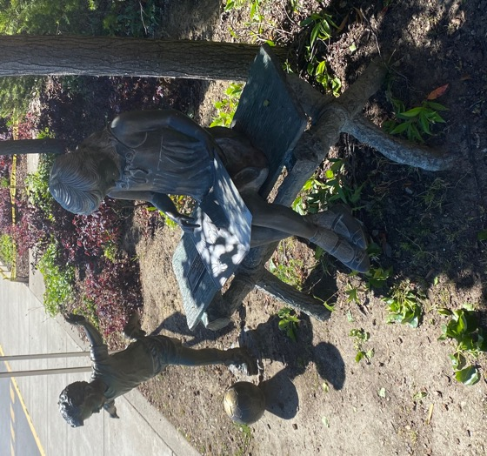
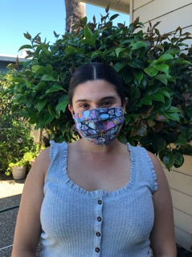
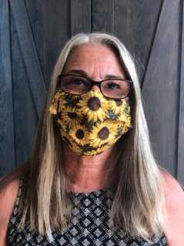
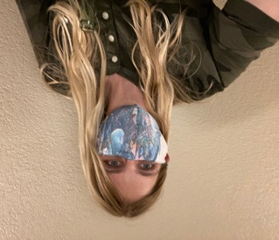
I can wave to the boy playing and the girl reading on the bench. Then a teacher will take me to my classroom and help me put my things away.

Slide 6
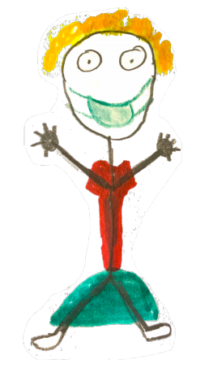
Just like my family, my teachers will be wearing masks. I will be able to see their eyes and hear their voices. The teachers will all have a picture of themselves in the classroom.
Hi, Friends!
I have missed you so much! I am very happy to see you!
Now it’s time to go into my classroom and see my friends!

Slide 7
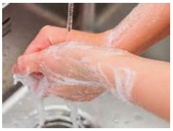
When I enter the classroom, the first thing I do is wash my hands.
This helps everyone to stay healthy.

Slide 8
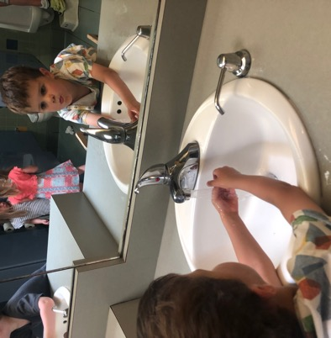
We will have to wash our hands a little more throughout the day:
We will still wash after we go to the bathroom, and before and after we eat.
We will also wash hands before we go outside and when we come back inside,
And of course, after we play with something messy!

Slide 9
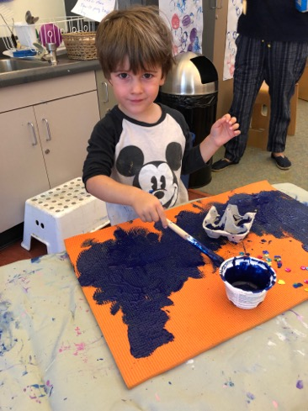
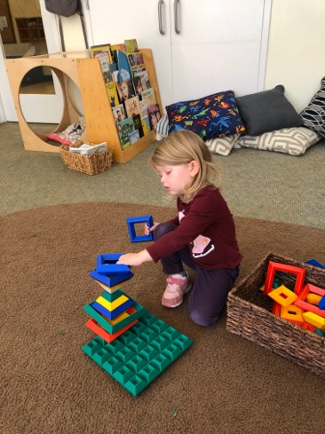
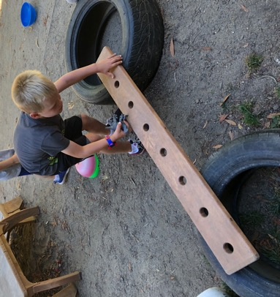
After washing, I can play. In order to keep everyone healthy, we will be staying in our own classroom and outdoor classroom instead of visiting other spaces in our school.
This helps keep germs from spreading.

Slide 10
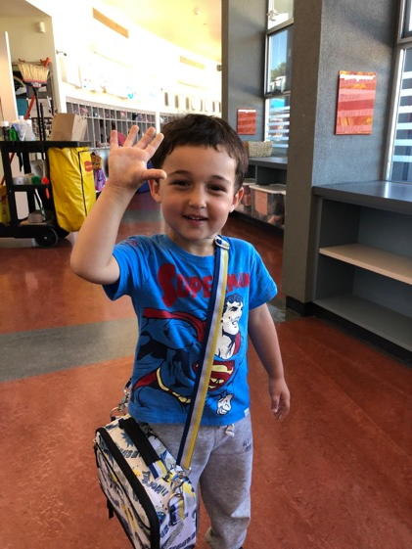
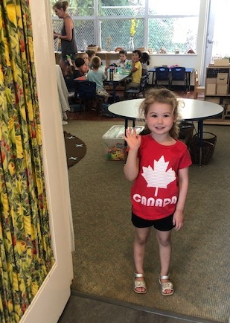
Staying in our classroom might make us miss friends and teachers in different classrooms.
We can still wave at them when we see them!

Slide 11
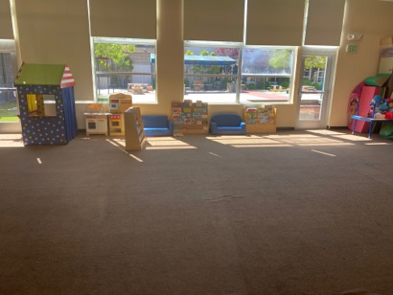
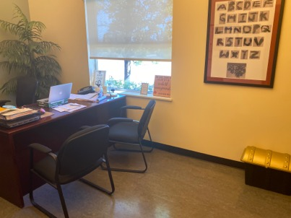
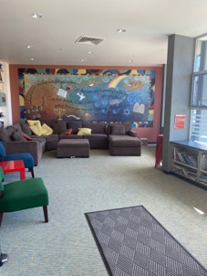

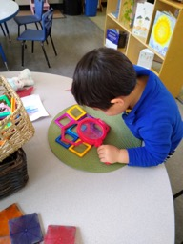
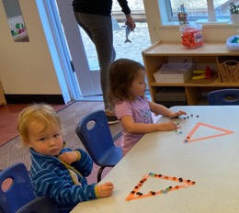
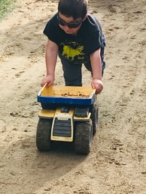
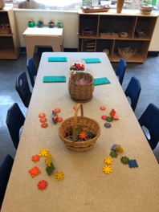
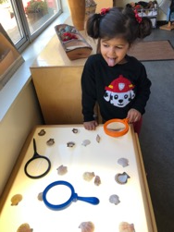
Staying in our classroom might make us miss other school spaces.
We have so many materials to use in our classroom! They are so much fun!

Slide 12
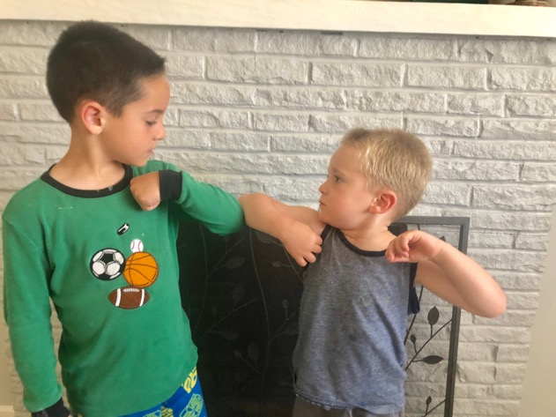
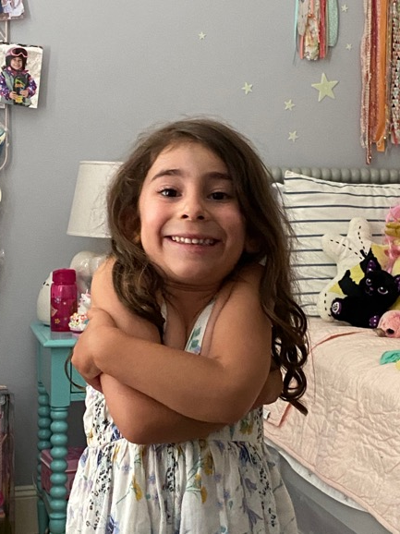
Hugging and touching our friends and teachers might spread germs.
We can do other things to show how much we love them, like bumping elbows or giving a sign language hug.

Slide 13
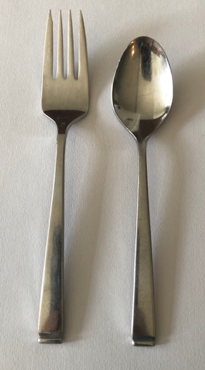
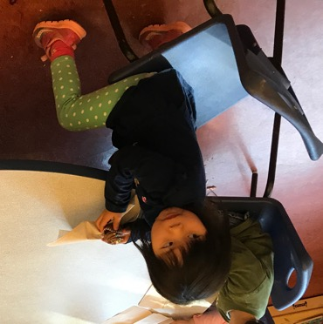
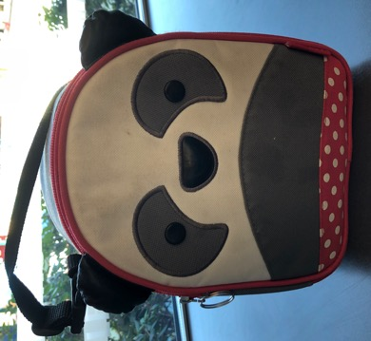
Instead of having school snack, I will be bringing my own snack to school – and of course my lunch. I will also bring my own forks and spoons.

Slide 14
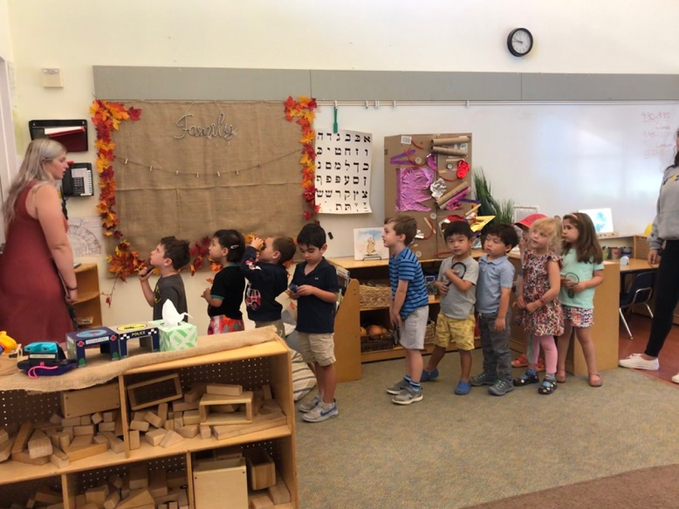
When it is time to go home, I will gather my belongings. A teacher will walk with me down the hallway. They will sit with me outside to wait for my family.
When my family arrives, I’ll wait for them to come over to get me. I can tell them all about my day.

Slide 15
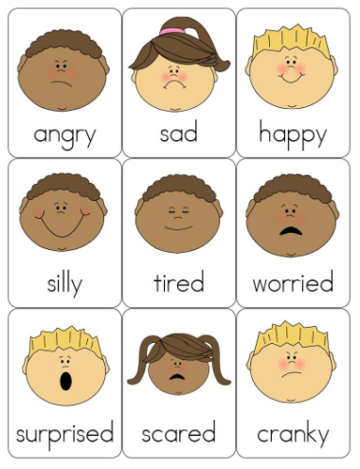
I notice that my day has some new routines. New ways of doing things can bring up many different feelings.
I might even feel different emotions all at the same time. It’s OK to feel whatever I am feeling.

Slide 16
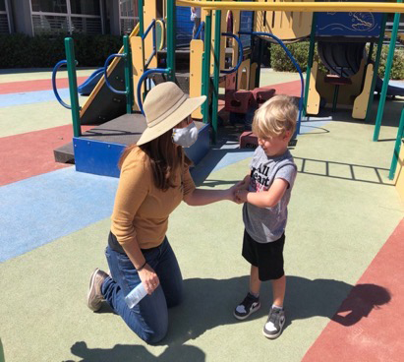
I can talk to my family, teachers, and friends about my feelings, the new routines, and any questions I have!

Slide 17
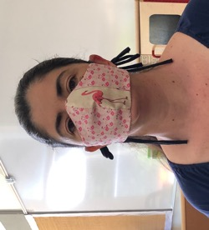
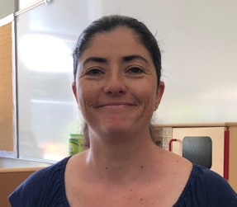
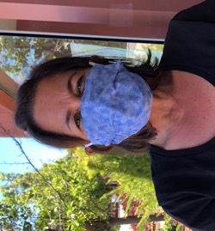
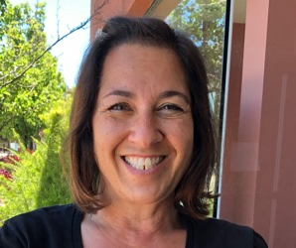
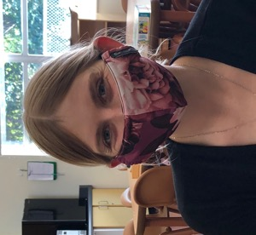
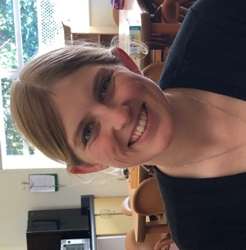
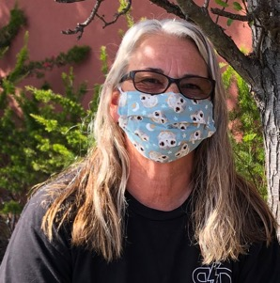
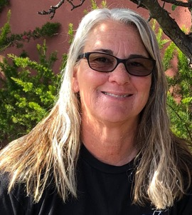
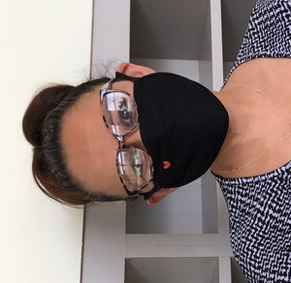
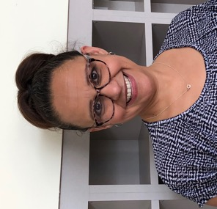
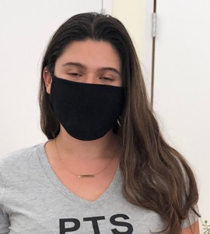
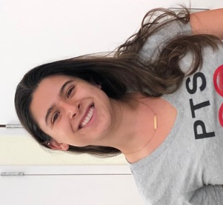
I can’t wait to see all the teachers this summer!

Slide 18
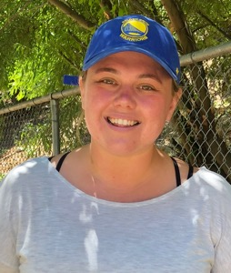
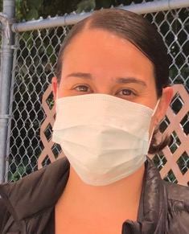
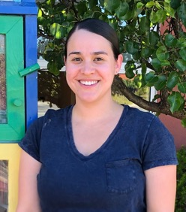









And they can’t wait to see me!

